Slide 1


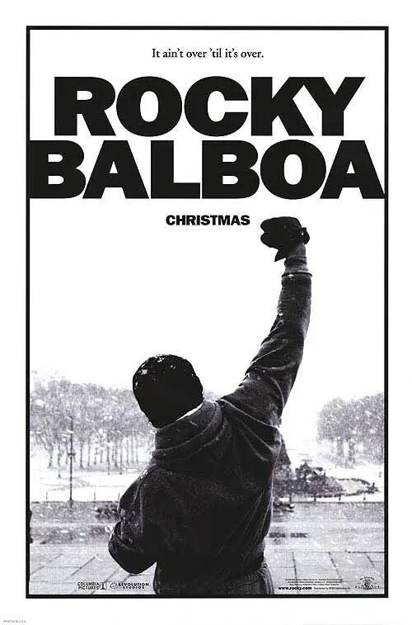

Boxing Presentation
Rocky
1976
Start Slide
Notes:
Today, i will talk about two actors from the movie Rocky: Sylvester Stallone and Burt Young

Slide 2
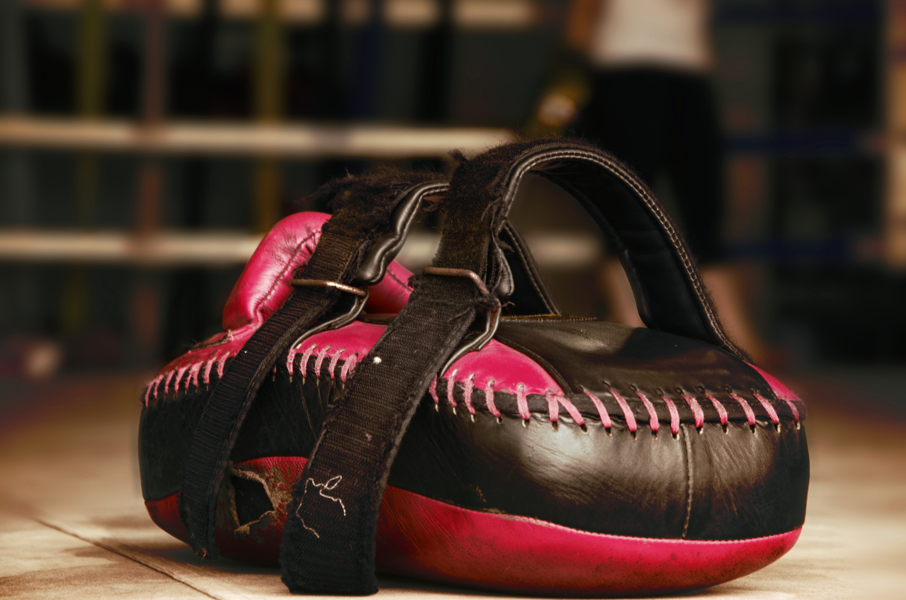
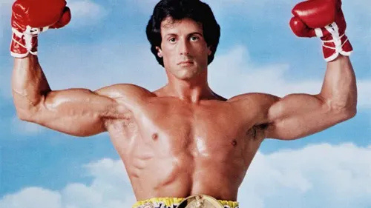
Boxing Presentation
About the boxer
Rocky
Sylvester Stallone was born into a poor family in New York on July 6, 1946.
Read More
About Us
Notes:
Sylvester Stallone was born in a poor family in New York. He had problems when he was born that made part of his face stay still, which changed how he talked and looked — this later became his special sign.

Slide 3
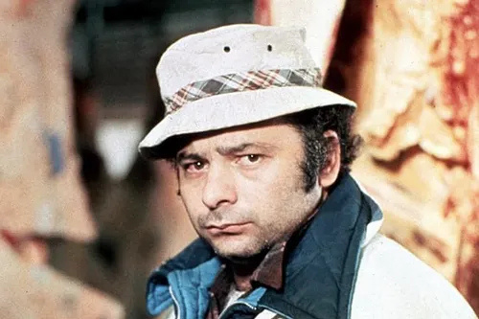
Boxing Presentation
About the assistent
Paulie
Burt Young also had a humble childhood in the Queens neighborhood, he was born April 30, 1940 in New York.
Read More
About Us
Notes:
Burt Young had a simple childhood in Queens, New York. He was the son of an Italian-American working family and grew up in a working-class neighborhood. He left school early and had a hard youth.

Slide 4
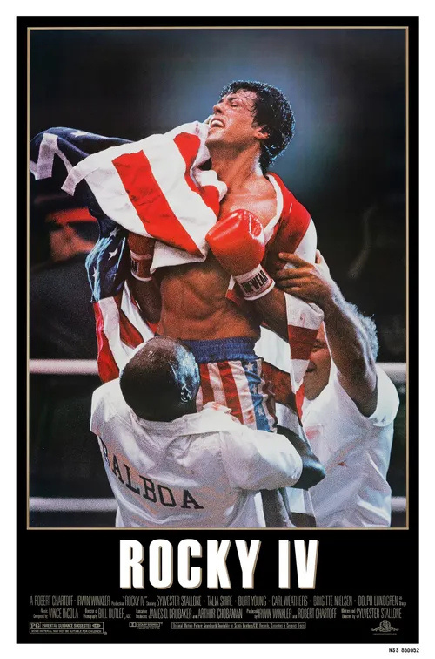
Boxing Presentation
Rocky
Birth problems and extreme financial difficulties
Determination with the Rocky script
Overcoming and success
Notes:
When he was young, he had no money and lost his home. He slept at a bus station for three weeks. He sold his dog for $25 because he had no food.
He wanted a better life, so he wrote Rocky in three days. Many people wanted to buy the story, but he said no unless he could act in the movie. He got the role and bought his dog back for $15,000.
The movie was very famous, won an award, and made Stallone a symbol of never giving up.

Slide 5
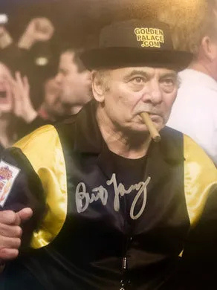
Boxing Presentation
Paulie
Humble origins and simple life
Crafts and street experience
Starting in cinema and a notable role
Notes:
Before he was famous, he did many hard jobs: he drove trucks, painted, helped workers, and even fought as a beginner boxer. He also worked in the Navy. He started acting by luck, with help from a friend, and learned acting from a famous teacher named Lee Strasberg, even though he didn’t go to acting school.
His real and hard life helped him play Paulie, Rocky’s grumpy brother-in-law. He acted as Paulie in almost all the movies and was known for acting in a true and honest way.

Slide 6

Boxing Presentation
Thank
You
End Slide

